Slide 1
For employer use only
Retiready activation and welcome journey
Retiready activation and welcome journey
For employer use only

Slide 2
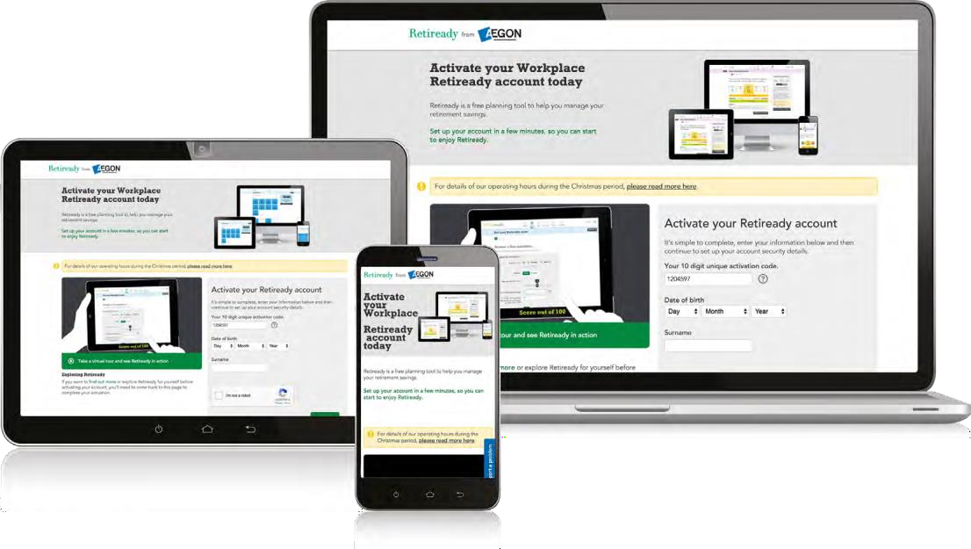
Retiready
The earlier your employees start engaging with their workplace savings, the earlier they’ll be on track to getting the retirement they want, when they want it.
Retiready has all the digital tools and information your employees need to manage their savings online, in one place. All they have to do is activate their online accounts.
We’ll send your employees an activation email to get them started, and the following pages show what happens next.
Welcome journey
If you want to see Retiready in action, and how easy it is to use, you can watch our short Retiready video.
We’ll also send your employees a series of emails encouraging them to engage with their retirement savings. You can find more information about this on page 10.

Slide 3
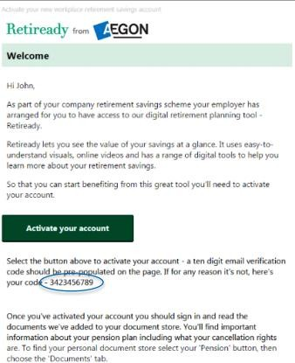
Activation email
Once you’ve added your employee’s details to the workplace scheme, the Retiready activation email will normally be sent to them within three working days.
To activate their account, the employee should click on the activation button within the email.

Slide 4
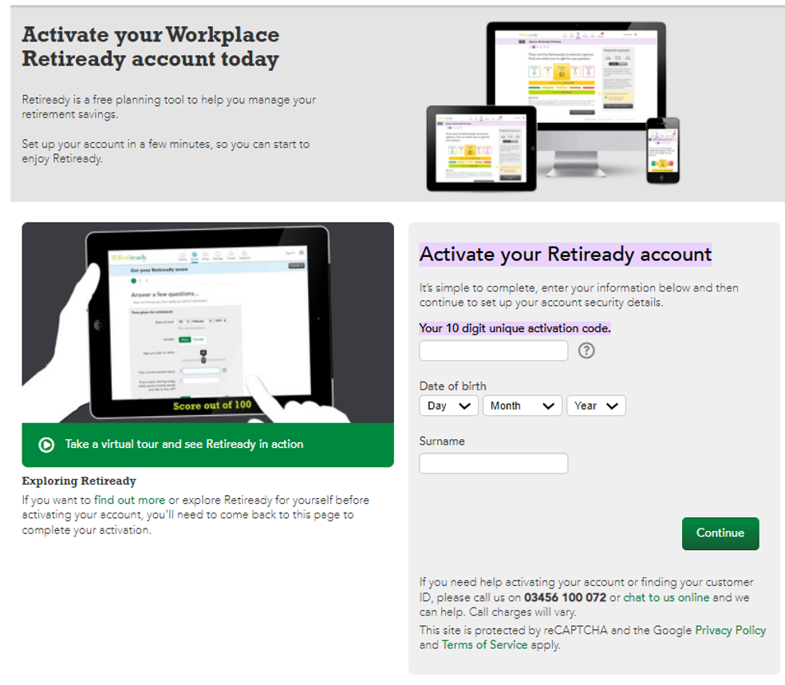
Account activation
The unique customer ID field will pre-populate if the employee has clicked through from the email.
Otherwise, the employee will need to enter their unique customer ID – which is in their email.
This ID is valid for 30 days.
The employee should also enter:
their date of birth and
surname.
Once completed, they should click on ‘Continue’.

Slide 5
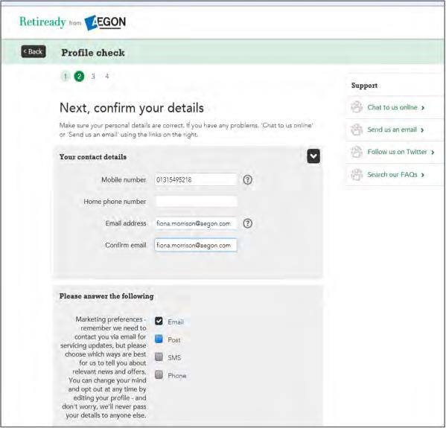
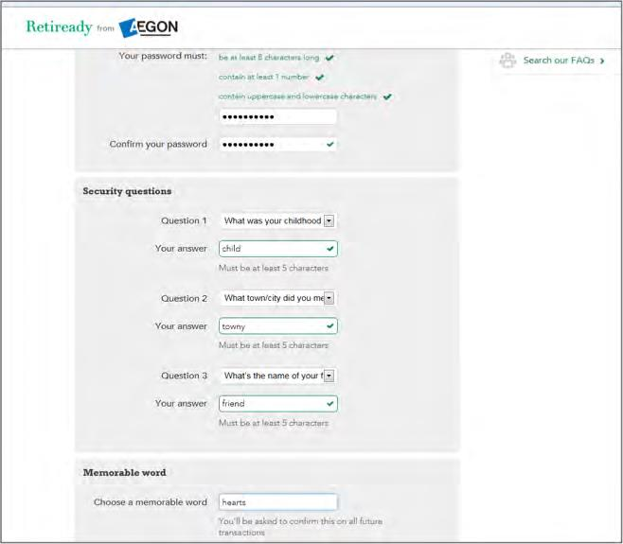
Profile information
Over the next few screens the employee will fill out their personal information and contact preferences.

Slide 6
Email verification
As part of the activation process, employees will be asked to validate their email address.
We’ll send an automatic email to the email address employees provide on their profile screen.
The employee should click on the verification link.
Hi Fiona,
You need to verify your email address
Your Retiready account is almost activated. All you need to do now is verify your email address.
Copy the six digit verification code and follow the verification link. You’ll be asked to enter the six digit email verification code to activate your account. It’s important you use the six digit code (and not your unique customer ID or email address).
Email verification code: 695064
Verification link: https://retiready.co.uk/public/getstarted/verify- email. html? verificationCode=695064&policyNumber=7087 5749
If you’re unsure which code to use, please chat to us online.

Slide 7
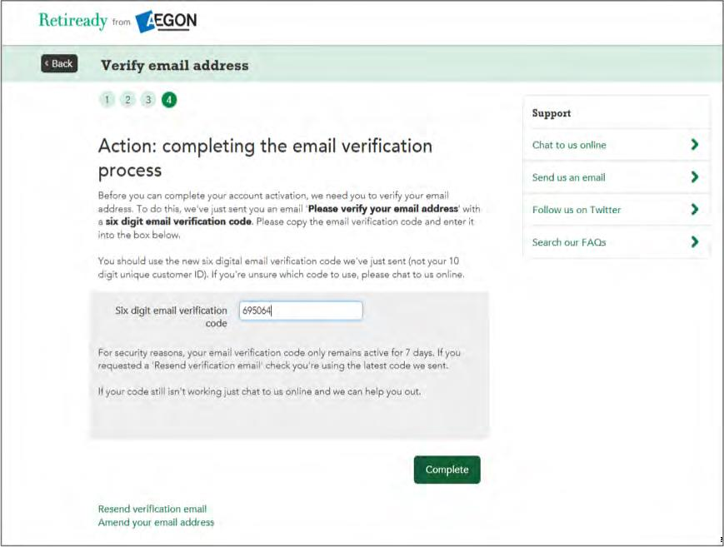
Email verification
The email verification code should be pre-populated, but if it isn’t, the employee should manually enter or paste their six-digit email verification code into the box provided – they’ll find it in their email.
This code will only be valid for seven days and the employee will need to request a ‘resend verification email’ if they verify their email outside this time.
Once they’ve done this, they should click on ‘Complete’.
Online chat is available if they experience any issues.

Slide 8
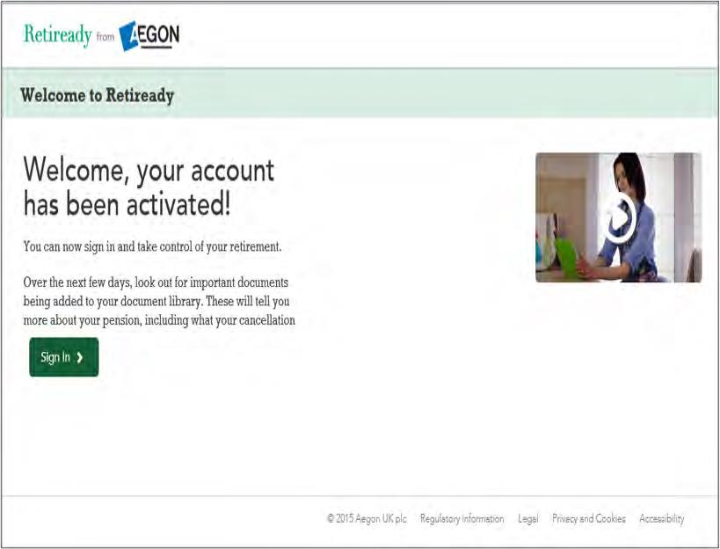
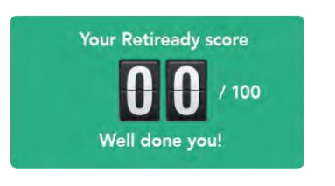
Confirmation and activation
The activation process will now be complete.
The employee can ‘Sign In’ to their Retiready account, and access all the available tools, including ‘Retiready Score’.

Slide 9
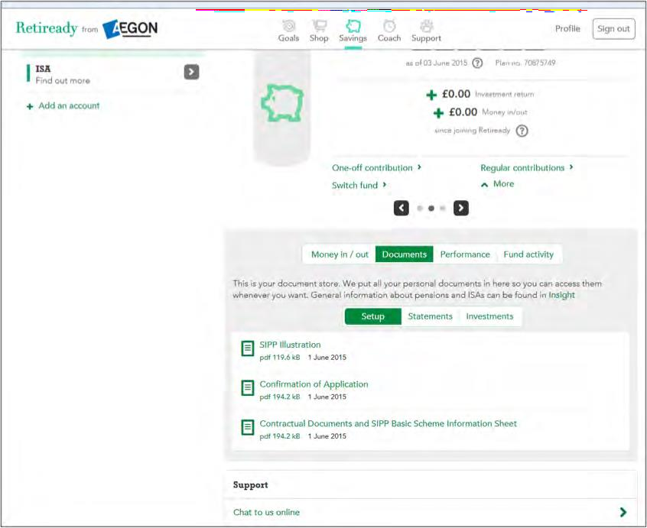
Retiready service
The employee will instantly have access to the full Retiready service.
It may be worth noting that when they first sign in, there may be no money showing in their account until the first contribution has been paid and applied.
Employees will have access to their personal document library, where they’ll be able to view important documents regarding their pension plan.

Slide 10
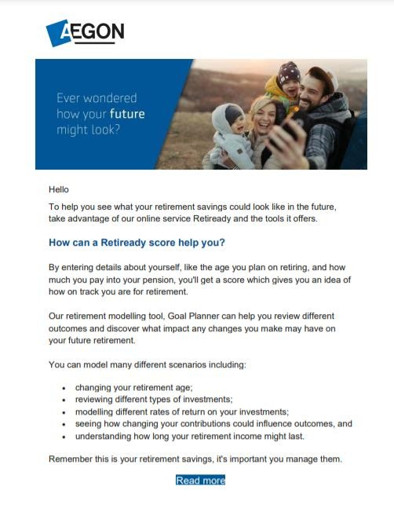
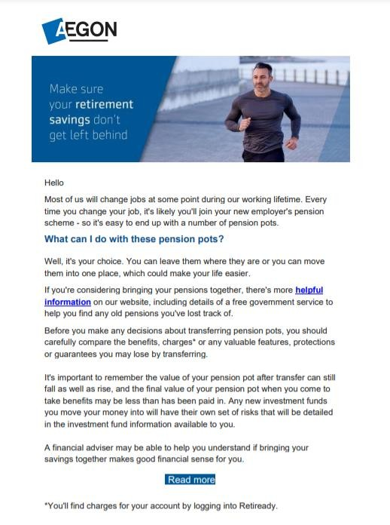
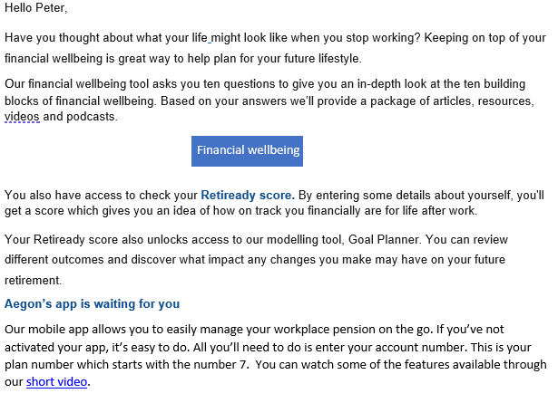
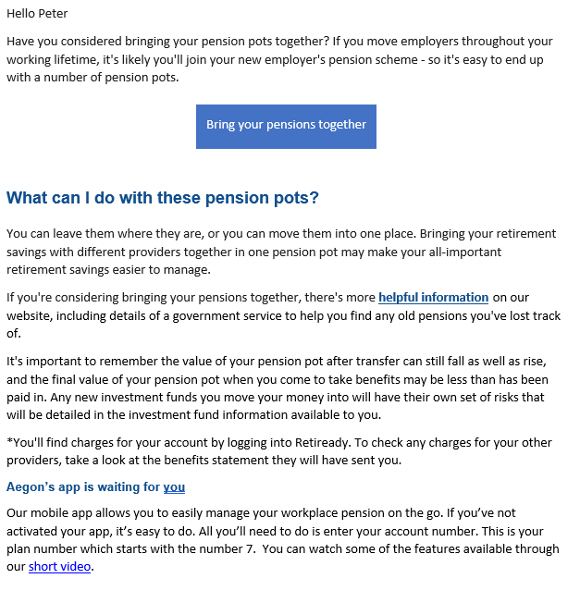
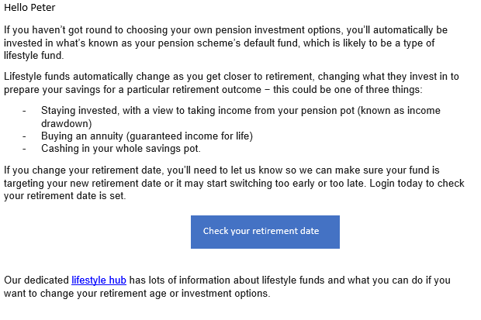
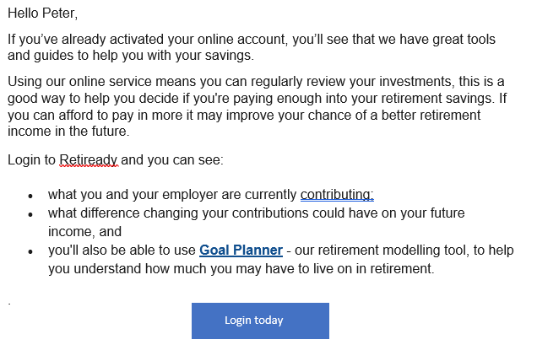
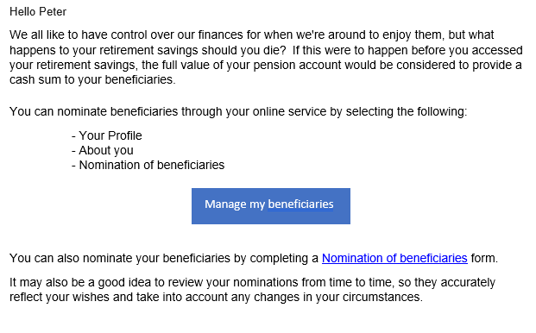
A warm welcome from Aegon
Month 3
Make sure your retirement savings don't get left behind - could you benefit from bringing all your pension pots together?
Month 2
Keep on top of your financial wellbeing to help plan your future lifestyle.
One month after your employees receive their activation email, they’ll begin to receive the welcome journey.
Each month, we’ll send them an email aiming to encourage them to think about their retirement savings.
It helps keep employees engaged, by giving them a quick link to log in to Retiready, or a reminder to activate their account if they haven’t already done so.
Month 4
Your retirement plan should be as individual as you are - take a little time to explore and understand your investment options
Month 5
Are you paying enough into your retirement savings - regularly reviewing your pension plan is a good way to help you decide.
Month 6
Have you nominated your beneficaries? You can do this online. You'll need to complete a new nomination form to include this new workplace pension.

Slide 11
Aegon is a brand name of Scottish Equitable plc (No. SC144517) and Aegon Investment Solutions Ltd (No. SC394519) registered in Scotland, registered office: Edinburgh Park, Edinburgh, EH12 9SE. Both are Aegon companies. Scottish Equitable plc is authorised by the Prudential Regulation Authority and regulated by the Financial Conduct Authority and the Prudential Regulation Authority. Aegon Investment Solutions Ltd is authorised and regulated by the Financial Conduct Authority. Their Financial Services Register numbers are 165548 and 543123 respectively. © 2024 Aegon UK plc
WP375536 07/24

